Slide 1
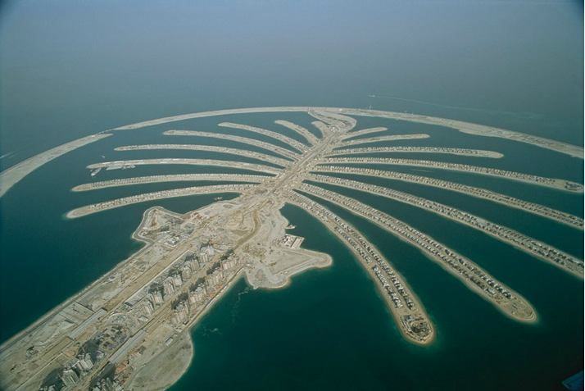
Introduction to Environmental Science
In every deliberation, we must consider our impact on the next seven generations.
- The Iroqouis Confederacy

Slide 2
Instructor Resources This slide does not appear while presenting
Fillable student notes outline:
http://www.aurumscience.com/environmental/1_introduction/notes_outline.html
Study guide:
http://www.aurumscience.com/environmental/1_introduction/studyguide.html
Other worksheets and assignments:
http://www.aurumscience.com/environmental/1_introduction/index.html
Next Unit: Principles of Science
http://www.aurumscience.com/environmental/2_science/index.html
Written by James Dauray
Written by James Dauray

Slide 3
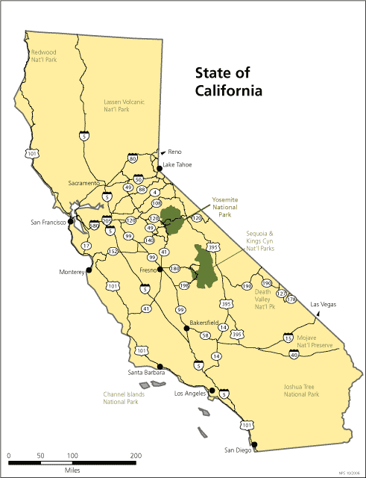
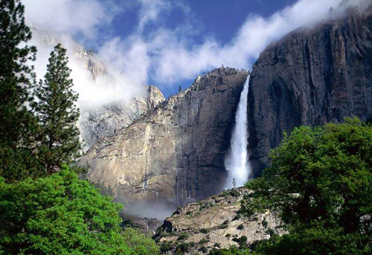
Yosemite National Park
Yosemite National Park is a national park directly east of San Francisco that was created in 1890.
Images taken from http://www.nps.gov

Slide 4
San Francisco
The city of San Francisco experienced a tremendous population boom in the 19th century due to the gold rush.
A powerful earthquake struck the city in 1906, followed by a devastating fire.
The city’s water pipes were so damaged by the earthquake, that firefighters were not able to tap fire hydrants.

Slide 5
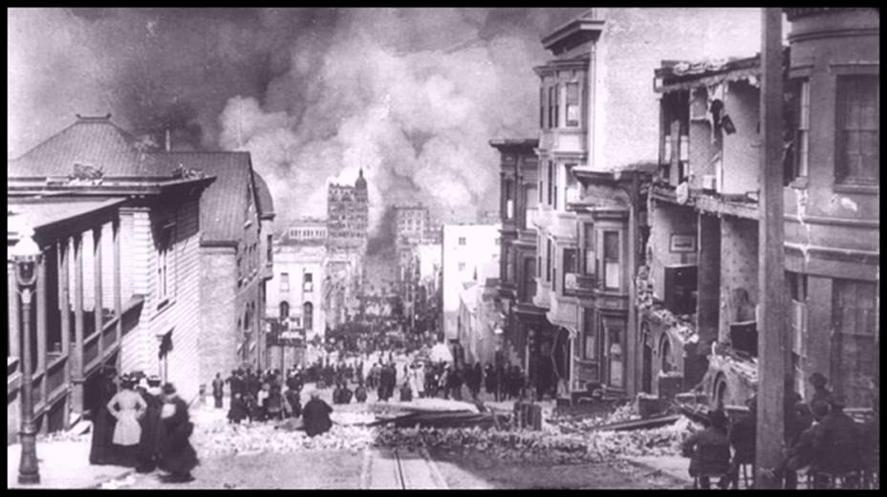
Earthquake of 1906
The economic and structural damage to the city is comparable to that of Hurricane Katrina and New Orleans.
As part of the rebuilding process, the city applied to the federal government to construct a reservoir in the Hetch Hetchy valley of Yosemite National Park.

Slide 6
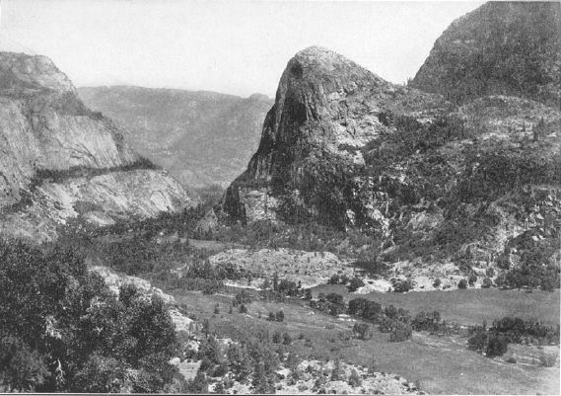
Hetch Hetchy Valley
Image taken from http://www.sierranevadaphotos.com
San Francisco city officials wanted to dam the Tolumne river for a clean and dependable long-term water source for a growing city.
An act of Congress and President Woodrow Wilson’s approval were needed for the dam and reservoir to be constructed.

Slide 7
Environmental Science
Environmental science is defined as the interaction of humans with the environment.
The environment includes all conditions that surround living organisms:
Climate
Air and water quality
Soil and landforms
Presence of other living organisms

Slide 8
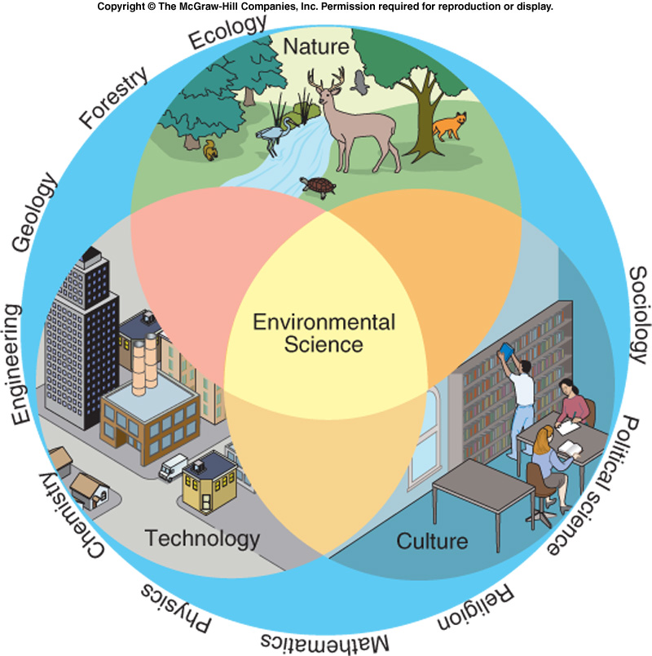
Environmental Science Cont’d
Environmental science and the issues that it studies are complex and interdisciplinary.
Includes concepts and ideas from multiple fields of study.
Image taken from Principles of Environmental Science, Cunningham, 2005.

Slide 9
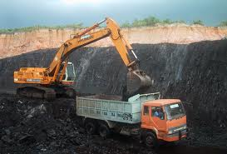
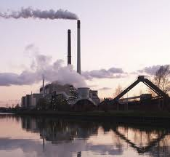
Decisions and Consequences
Every decision that we as a society make has consequences for the rest of the planet.
For example, using coal for electricity.
The coal must be mined.
When it is burned at a power plant, air pollution is released.
Some of the pollution is converted to acid in the atmosphere.
This falls as acid rain, stressing aquatic animals or plants.

Slide 10
Three Major Environmental Problems
Resource Depletion
A great deal of resources are needed to support the human population (~7 billion).
Renewable resources can be replenished within a human lifetime.
Timber, water.
The supply of nonrenewable resources is not replenished as quickly, and can be used up.
Coal, oil, minerals.

Slide 11
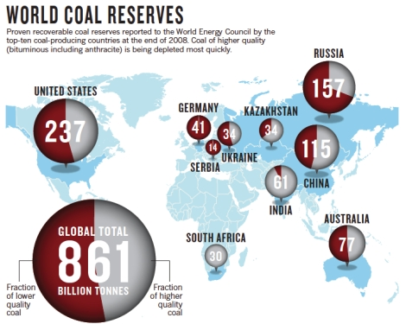
Coal Reserves
World coal reserves as of 2008. Estimated about 250 years at current rate of use.

Slide 12
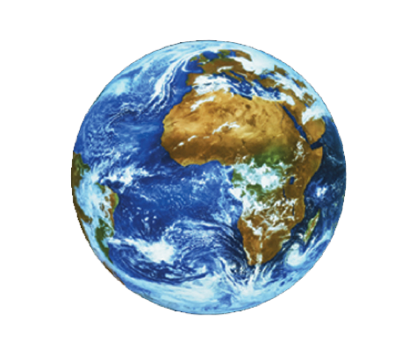
Spaceship Earth
The Earth is a closed system.
The only thing that enters or leaves the Earth in large quantities is heat.
Resources are limited, but the population continues to increase.
Wastes do not go away.

Slide 13
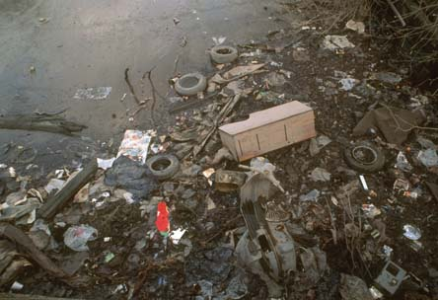
Major Environmental Problems
Pollution
Pollution is a degradation; an undesired change in air, water, or soil that affects the health of living things.
Biodegradable pollution will break down naturally over time.
Nondegradable pollution does not break down.

Slide 14
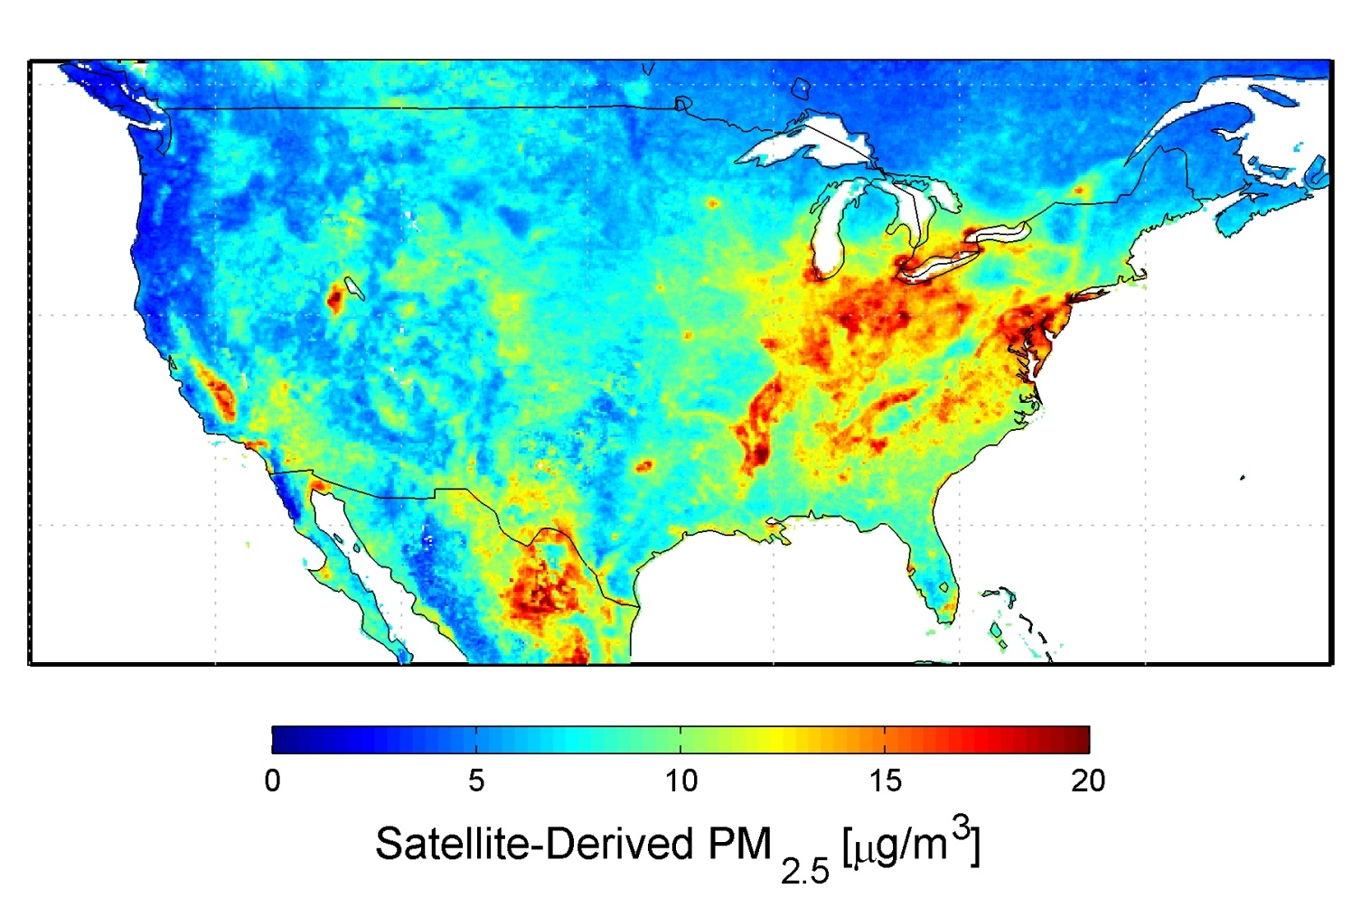
Pollution
One of the biggest challenges with pollution is that it moves, affecting areas far away from the source.

Slide 15
Major Environmental Problems
Loss of Biodiversity
The number of species on the Earth is unknown, but estimated to be in the tens of millions.
Biodiversity is the number of different species present in one specific ecosystem.
Extinction, or the complete loss of a species, is a natural event that can be accelerated by human actions.

Slide 16
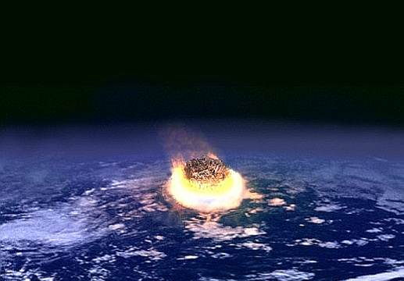
Loss of Biodiversity
Extinction is a normal event.
The most recent major extinction, about 65 million years ago, caused 75% of all species to disappear from the Earth.
Believed to have been caused by a meteor impact.

Slide 17
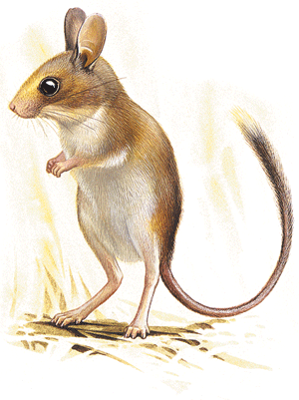
Loss of Biodiversity
Assuming no catastrophic events occur, extinctions occur at a pretty slow rate.
Scientists believe we may be in the midst of the next major extinction event, due to human influences.
Australia has experienced 27 mammal extinctions since 1788, primarily due to the influence of European settlers.
Normal background extinction rate is 1 mammal every 200 years.
The short-tailed hopping mouse, now extinct in Australia.

Slide 18
Environmental Ethics
Environmental ethics is the discipline that studies the moral relationship of human beings to the environment.
What is the value of the environment?
What moral responsibility do we have in dealing with the major environmental problems?
Which needs should be given the highest priority in our decision making?
Two main catergories of ethics have emerged in human culture in modern history.

Slide 19
Anthropocentrism
Anthropocentrism literally means “human-centered”.
This set of ethics protects and promotes of human interests or well-being at the expense of all other factors.
Often places an emphasis on short-term benefits while disregarding long-term consequences.

Slide 20
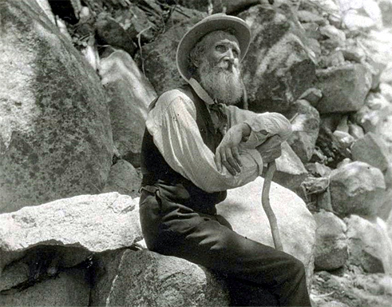
Ecocentrism
Advocated by John Muir, first president of the Sierra Club.
Ecocentrists believe that nature deserves to exist for its own sake regardless of degree of usefulness to humans.
The preservation of ecosystems or other living things takes priority over human needs.

Slide 21
Hetch Hetchy Debate
The debate about whether to build a dam in the Hetch Hetchy valley was one of the first big debates between these two philosophies.

Slide 22
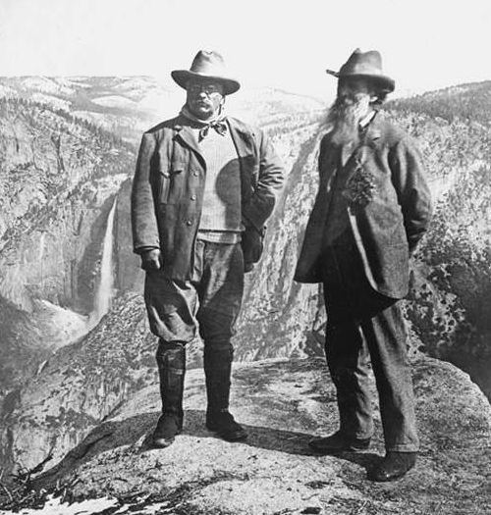
Resource Conservationists
The dam was eventually constructed.
The justification for building it was best stated by Gifford Pinochet, the first man in charge of the U.S. Forest Service.
"Where conflicting interests must be reconciled, the question shall always be answered from the standpoint of the greatest good of the greatest number in the long run.“
This philosophy, called resource conservationism, was also advocated by Teddy Roosevelt.

Slide 23
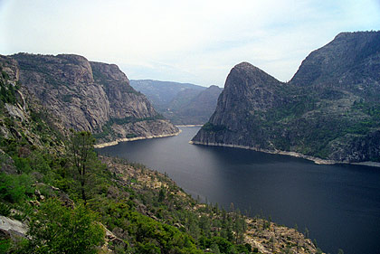
Before and After

Slide 24
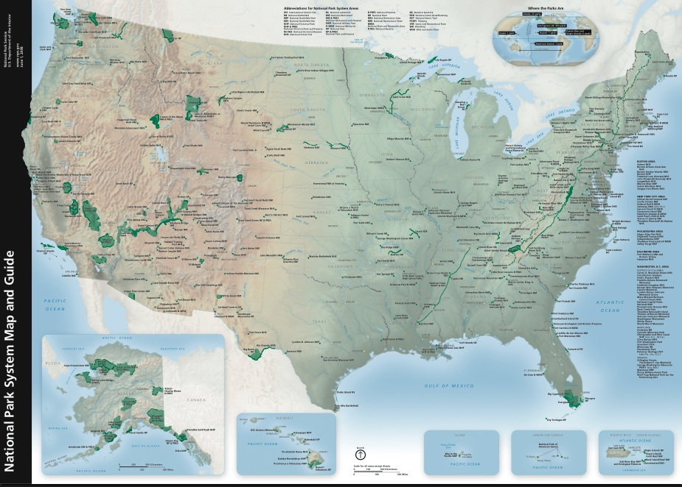
Resource Conservationists
The focus of the resource conservationists was to protect open land.
The National Parks system, and the National Forest system were both created during this time.

Slide 25
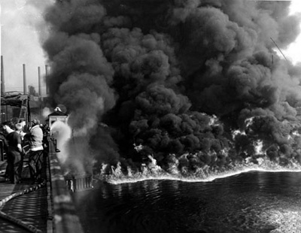
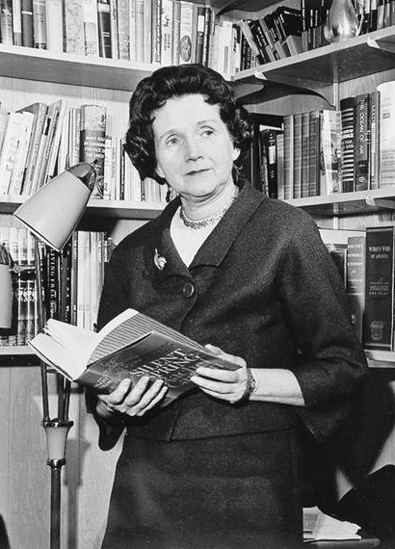
Modern Environmentalism
In 1952, the Cuyahoga river in Ohio caught fire due to all the pollution that had accumulated in it.
Rachel Carson published a book in 1962 entitled Silent Spring about the effects of pesticides on large predatory birds, particularly the bald eagle.
This began a public awakening to threats of pollution and toxic chemicals to humans as well as other species.
This is called the Modern Environmentalistm movement.

Slide 26
Global Environmentalism
Increased travel and communication enables people to know about daily events in places unknown in previous generations.
Issues and problems are explored on a global scale instead of a local one.

Slide 27
The Environmental Conflict
A great deal of progress has been made since the birth of modern environmentalism, but many debates still rage on.
An ecologist named Garrett Hardin wrote an essay describing the source of environmental problems as a conflict:
Short-term interests of individuals
versus…
Long-term interests of civilization and the Earth itself

Slide 28

Tragedy of the Commons
Each villager owns a small herd of sheep.
The only place for the sheep to graze is a commons in the center of the village.
A commons is an area that belongs to an entire village.
Likely outcome: Villagers obtain as many sheep as possible, allow to graze in the commons.

Slide 29
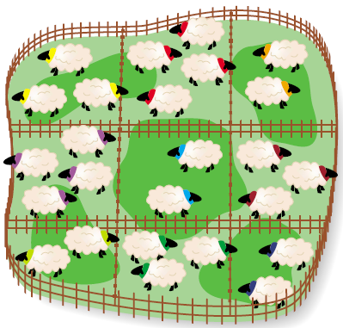
What if the commons was instead divided into sections that was owned by each villager?
Because the land is owned, individuals are much more likely to plan and use it for the long-term.
“In the history of the world, no one has ever washed a rental car.”
Larry Summers, Chief Economic Advisor to President Obama

Slide 30
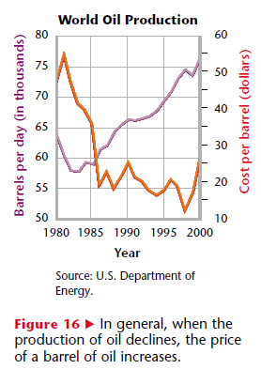
Economics and the Environment
Supply and Demand – The greater the demand for a limited resource, the higher the price.
Examples:
Increasing price of oil/gasoline.
Consistently low price of corn in U.S.

Slide 31
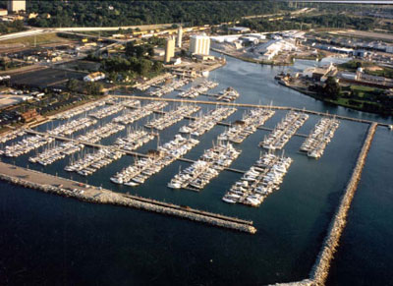
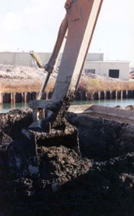
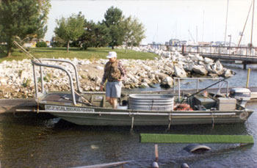
Economics and the Environment
Cost/Benefit Analysis – Is the cost of doing something worth the price?
Ex: Pollution cleanup of Waukegan Harbor
Waukegan harbor
Annual fish sampling
Dredging

Slide 32
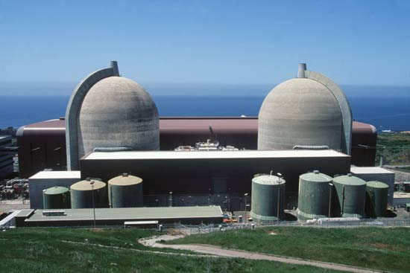
Economics and the Environment
Risk Analysis – The probability that something will cause injury or death.
Ex: Nuclear power

Slide 33
Case Study: Bhopal and Dow Chemical
In December of 1984, a pesticide factory located near the town of Bhopal, India leaked a large amount of toxic chemicals into the air.
The chemicals resulted in an immediate death toll of about 3,000 people, with 8,000 more dying of long-term health ailments.
A total of 558,125 injuries were reported to the Indian government.
No legal settlement was reached with Union Carbide, now owned by Dow Chemical.

Slide 34

The Yes Men Fix the World. Dir Andy Bichlbaum, Mike Bonanno. Charny/Bacharach Entertainment, 2009.

Slide 35

Ethics and Economics
To properly compensate and treat all individuals affected by this disaster, Dow Chemical would have to pay several billion dollars in settlements.
Dow Chemical has a yearly profit of over $2 billion, with total assets worth nearly $70 billion.

Slide 36
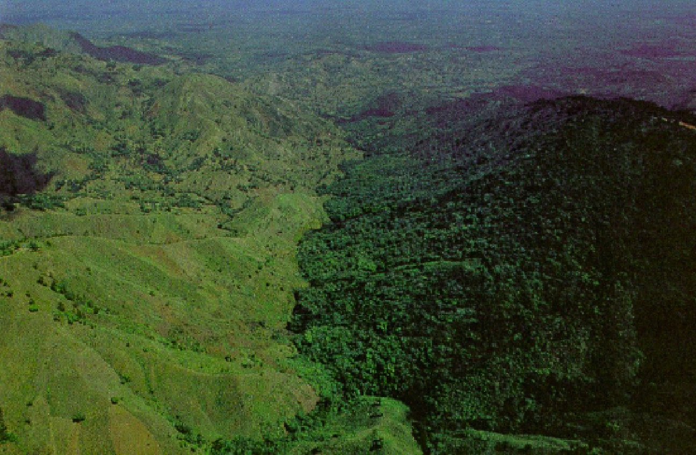
The Demographic Divide: Developed and Developing Nations

Slide 37
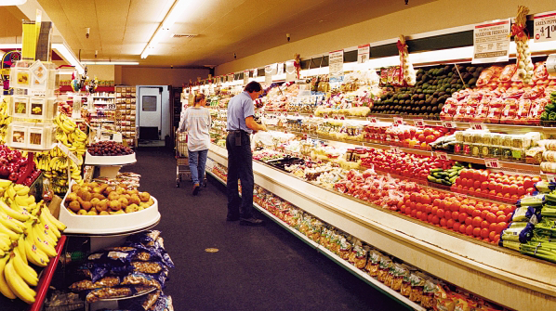
Developed and Developing Countries
Environmental issues faced by different countries varies depending on their economic status.
Developed – Higher incomes, longer life span, lower growth rate.
Ex: United States, Japan, France, U.K.

Slide 38
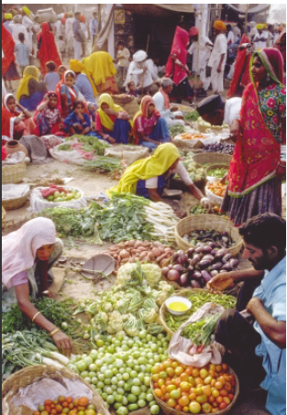
Developing and Developed Countries
Developing – Have lower incomes, shorter life span, rapid population growth.
Ex: India, Afghanistan, most of sub-Saharan Africa

Slide 39
Population and Consumption
Developing countries tend to have severe overpopulation. This leads to:
Deforestation
Bare soil
Native animals driven to extinction
Malnutrition, starvation, disease
About 80% of the world’s population falls in this category
Only use 25% of the world’s resources

Slide 40
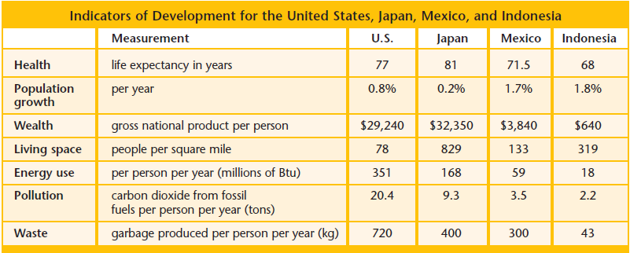
Developing and Developed Countries
Source: Holt Environmental Science, Arms, 2007

Slide 41
Population and Consumption
Developed countries, while smaller in size and growth, consume resources at a greater rate.
About 20% of the world’s population uses 75% of its resources.

Slide 42
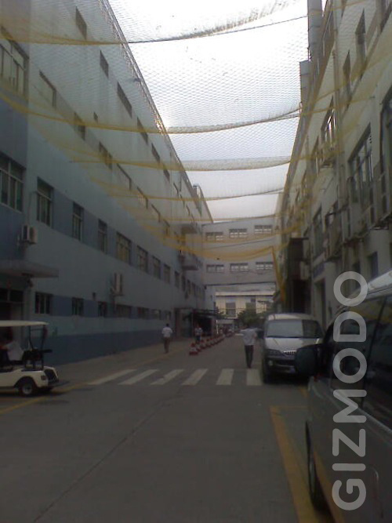
Developing Countries
Many products used in developed countries are produced in developing countries.
Working conditions and pay in these countries is often at levels that would be unacceptable elsewhere.
Foxconn, a computer chip company, experienced a rash of suicides at its China factory 2010.

Slide 43

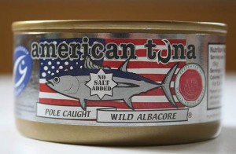
Example
StarKist brand chunk light tuna in water
Price at Jewel-Osco grocery: $0.99
American Tuna brand wild albacore tuna in water
Price at Whole Foods market: $4.99
What are the hidden costs behind that $4.00 price difference?

Slide 44
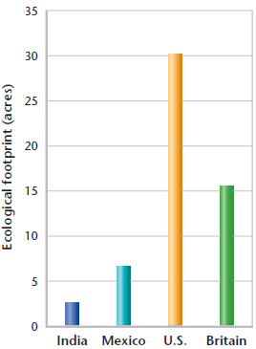
Ecological Footprint
An ecological footprint is one measurement of a person’s resource use.
Includes the amount of space needed to support each person in a nation, including forests, farms, cities, etc.
Developed countries have a much larger footprint, reflecting a much larger use of resources.

Slide 45
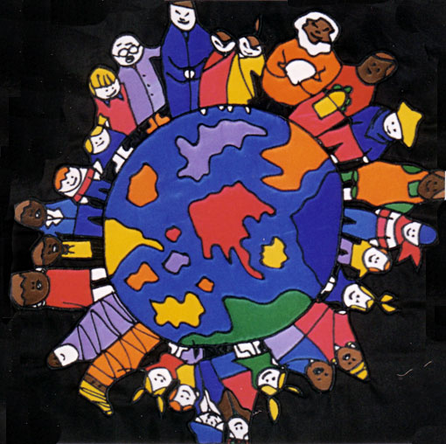
The Goal: A Sustainable World
Sustainability
Human needs are met so that the population can survive
indefinitely.
“Meeting the needs of the
present without
compromising the ability of
future generations to meet
their own needs.”
Brundtland Commission, 1987

